Slide 1
Redesigning CHIML: Orchestration Language for Chimera Framework
Go Frendi Gunawan, Jozua Ferjanus Palandi,
Subari

Slide 2
Problem
How to make an orchestration language in order to make components work together
The components can be implemented in different programming languages
The orchestration language should be simple and readable
The orchestration language should support “Programming in Large and Programming in Small”

Slide 3
Previous Solutions
UNIX Pipe: Programming in Large, not so readable for complex problem
CORBA, EJB, BPEL: Programming in Large, has a very specific protocol
SOAP: Has a very specific protocol (depend on HTTP)
XML-RPC, JSON-RPC, G-RPC: Depend on HTTP
Chimera-Framework ← [we improve this]

Slide 4
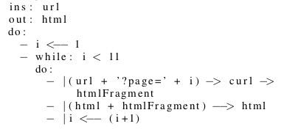
How it looks like (fetch page 1-10)

Slide 5
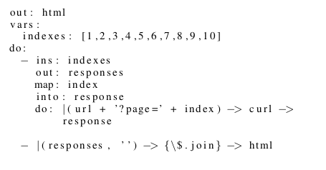
How is it Looks Like? (fetch page 1-10)

Slide 6
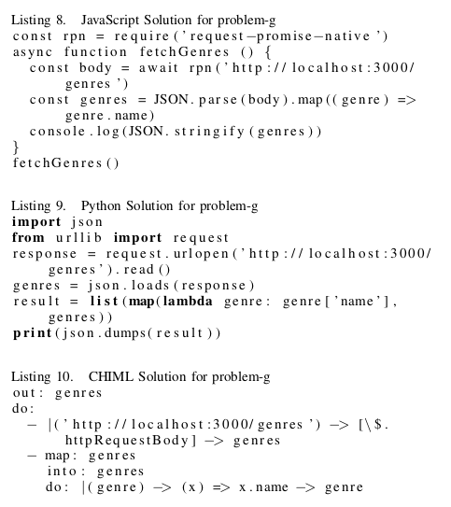
Comparison (JavaScript vs Python vs CHIML)

Slide 7
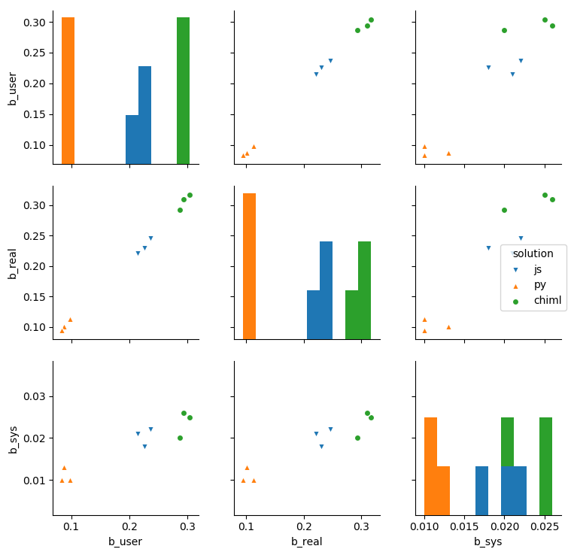
Comparison (benchmark)

Slide 8
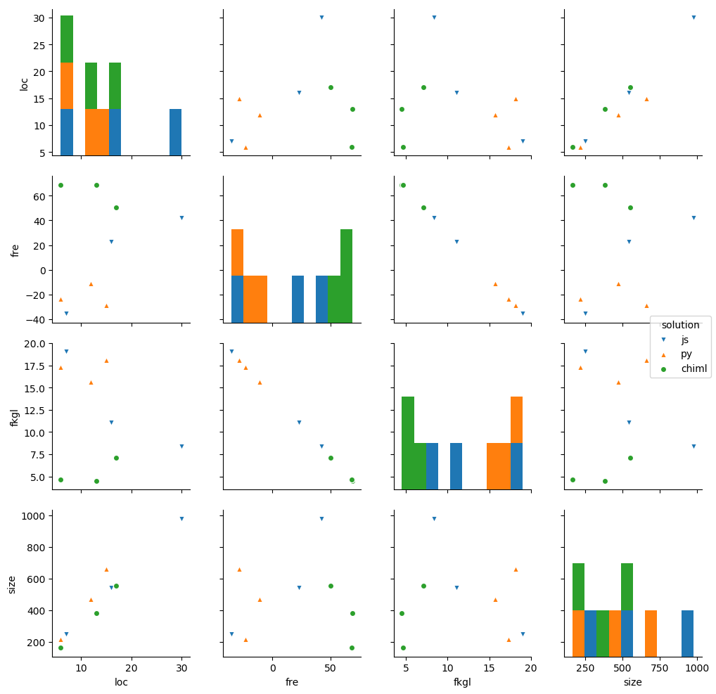
Comparison (Readability)

Slide 9
Expected Output
International Publication (Conference/Journal)
CHIML Implementation in Chimera Framework

